Slide 1



gmx
analysis
FINS5547- MAJOR PROJECT

Slide 2




WHAT IS GMX

Slide 3
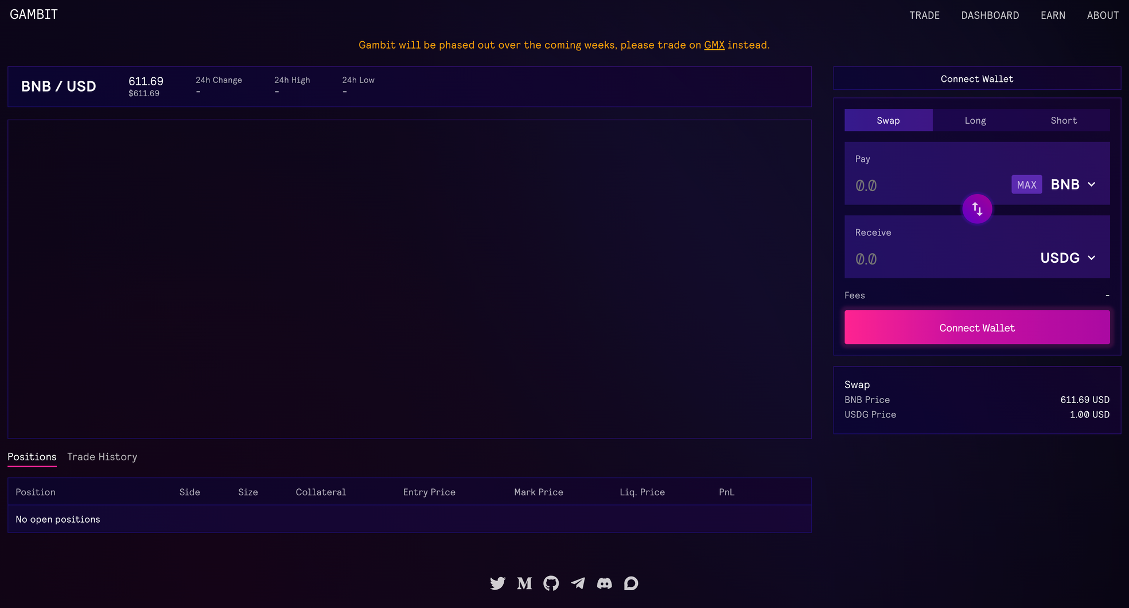
Originally Gambit Financial on the Binance Smart Chain (BSC)

Slide 4
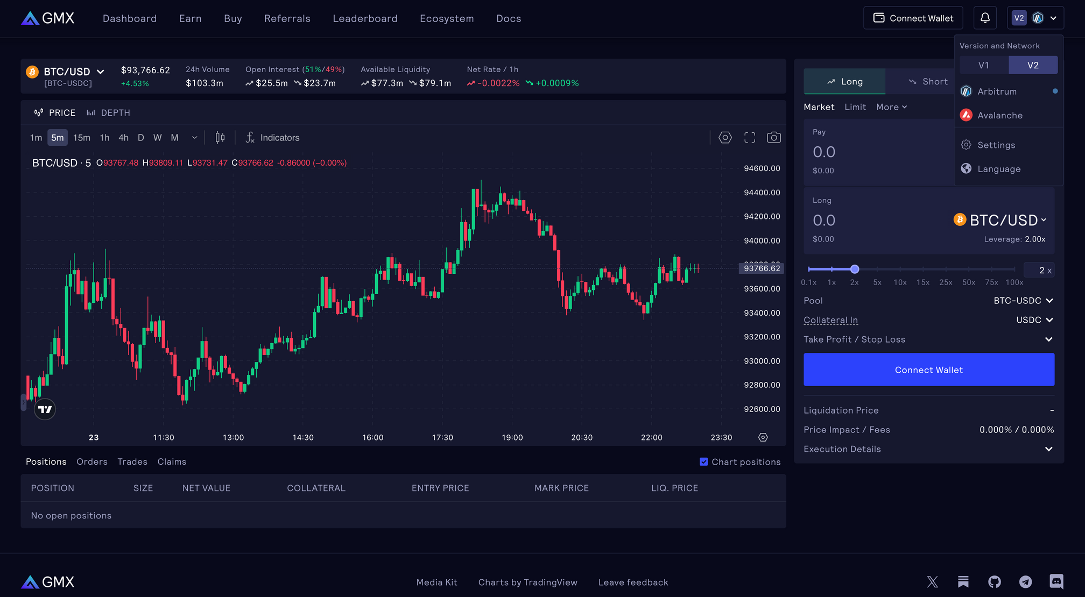
Up to 100x leverage
Users can use by connect wallet, don’t need kyc
Deployed on Arbitrum and Avanlanche

Slide 5
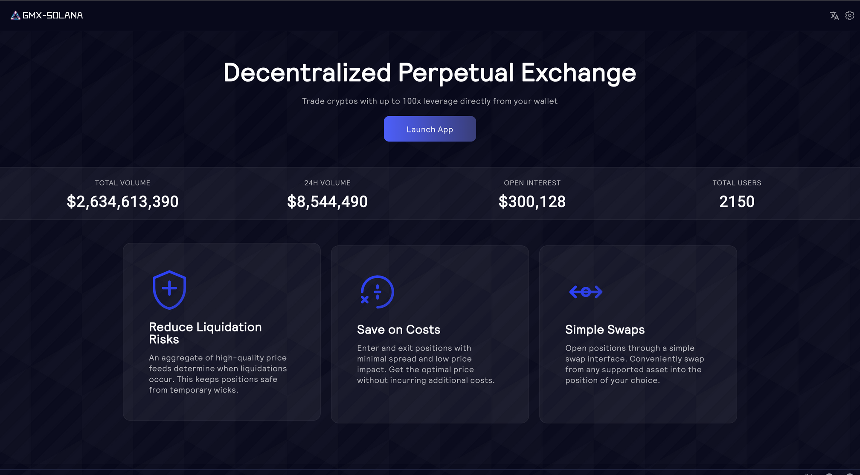
expanded to Solana in March 2025

Slide 6
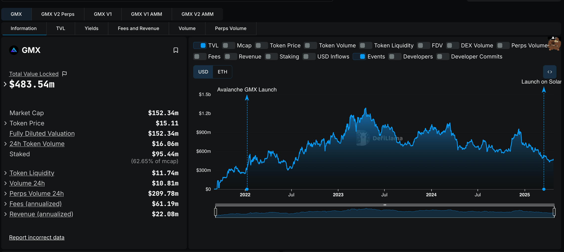

Slide 7


Krunal Amin
(UniDex)
Benjamin Simon
(Stealth Crypto)

Slide 8


What does it do ?

Slide 9
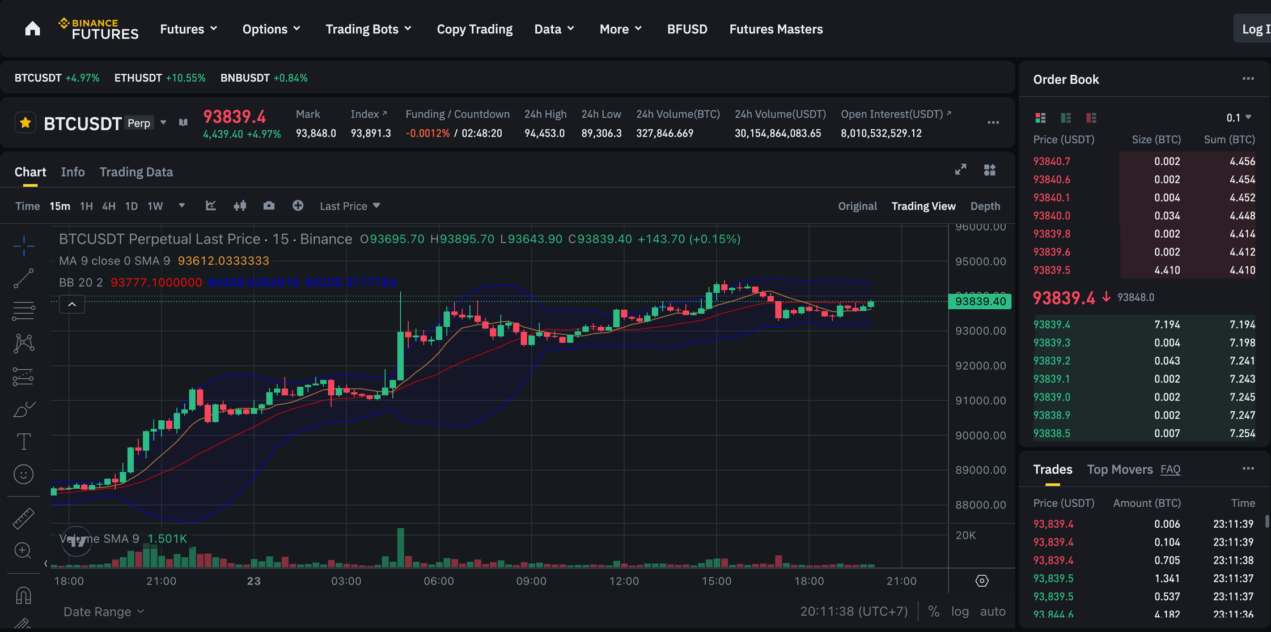
Derivatives trading happens largely on centralized exchanges

Slide 10
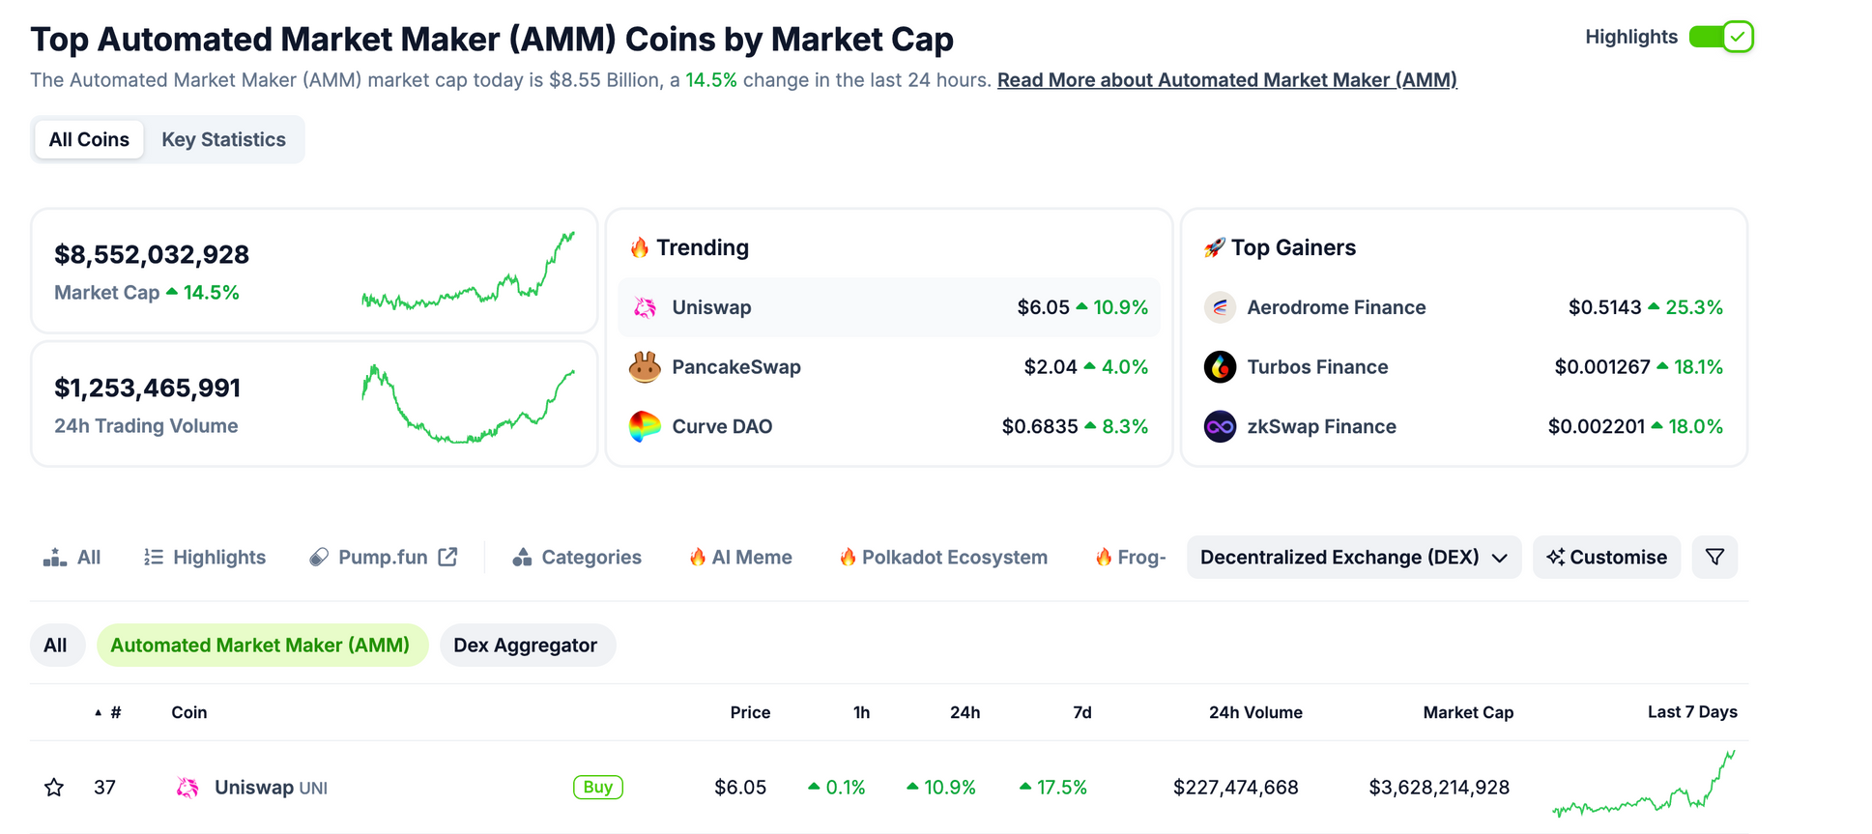
Perpetual trading protocols are still nascent.

Slide 11

Aims to...
  On-Chain Binance: GMX targets the growing on-chain trading market
  Hard to Fork: Unique incentives and features set it apart from basic DEXes

Slide 12
  Differentiated Positioning: Stands out with unique protocol mechanics and tokenomics
  GLP Liquidity Model: Enables zero-slippage trades, unlike traditional AMMs like Uniswap
  Accurate Pricing: Uses Chainlink to aggregate prices from major exchanges for reliable, manipulation-resistant data

Slide 13

DECENTRALIZATION OF GMX AND ITS TOKEN USE CASE

Slide 14
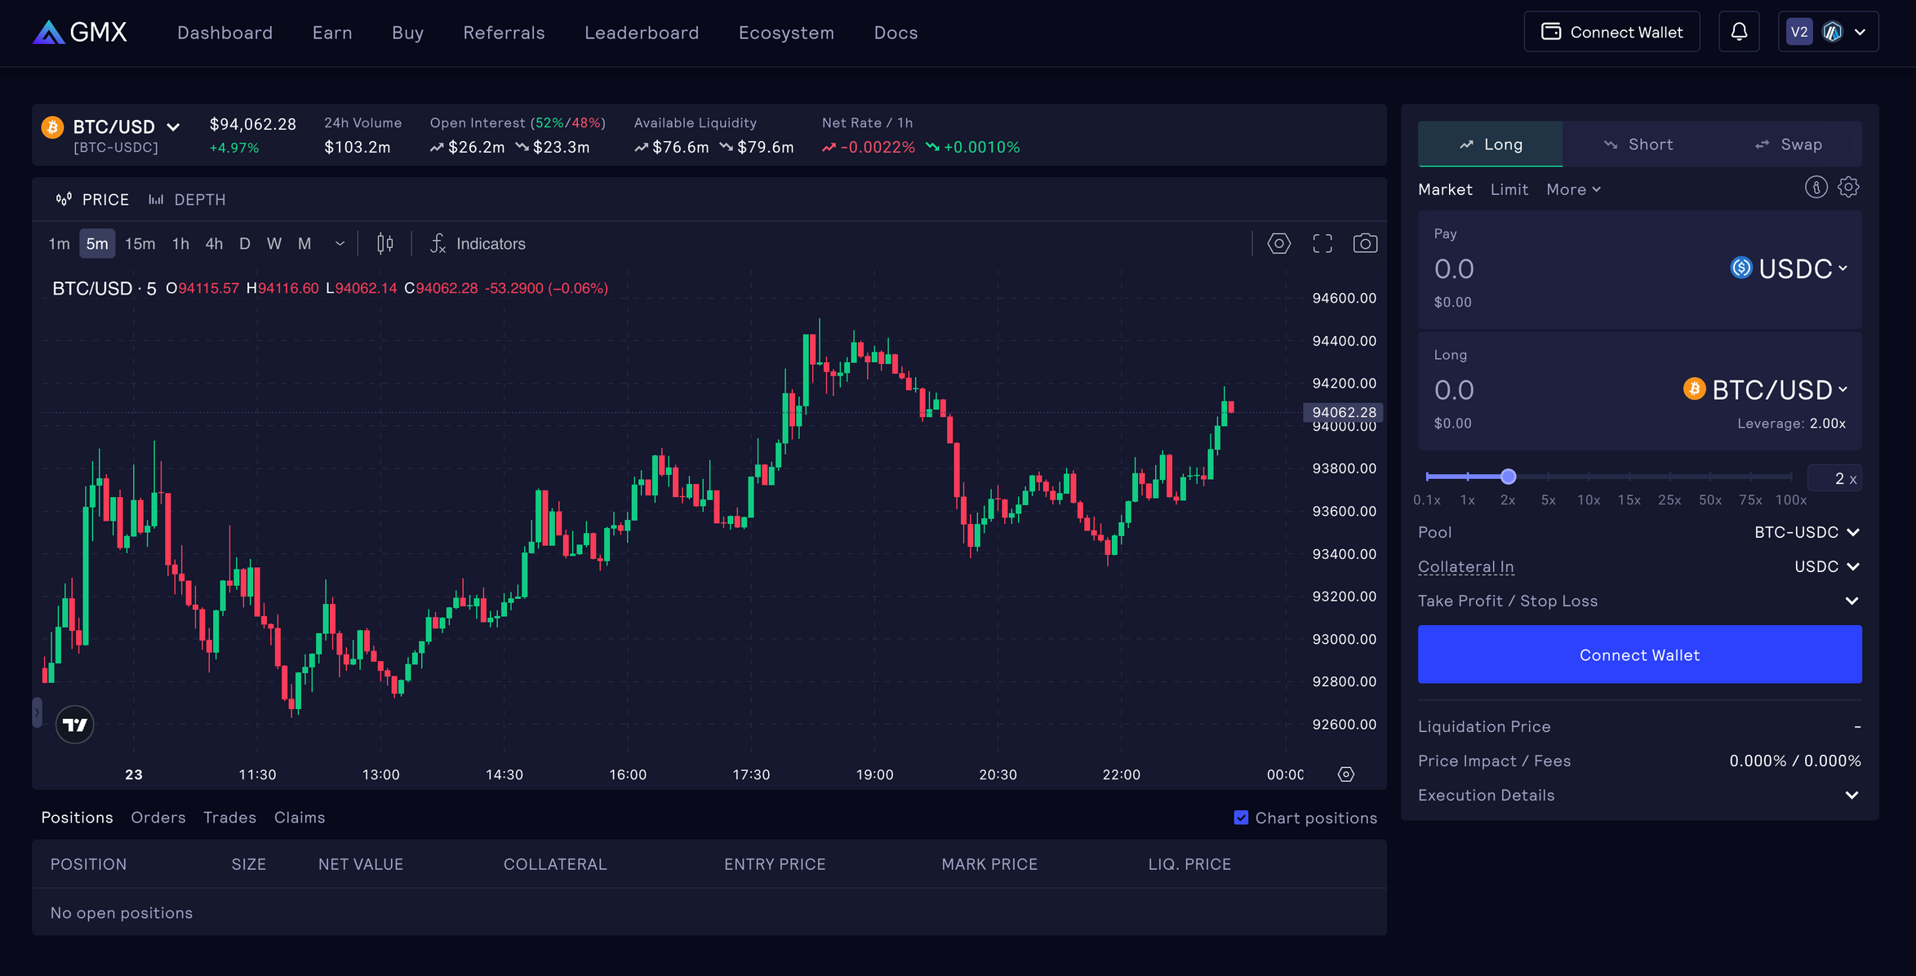
GMX DOES NOT OPERATE AN ORDER BOOK

Slide 15
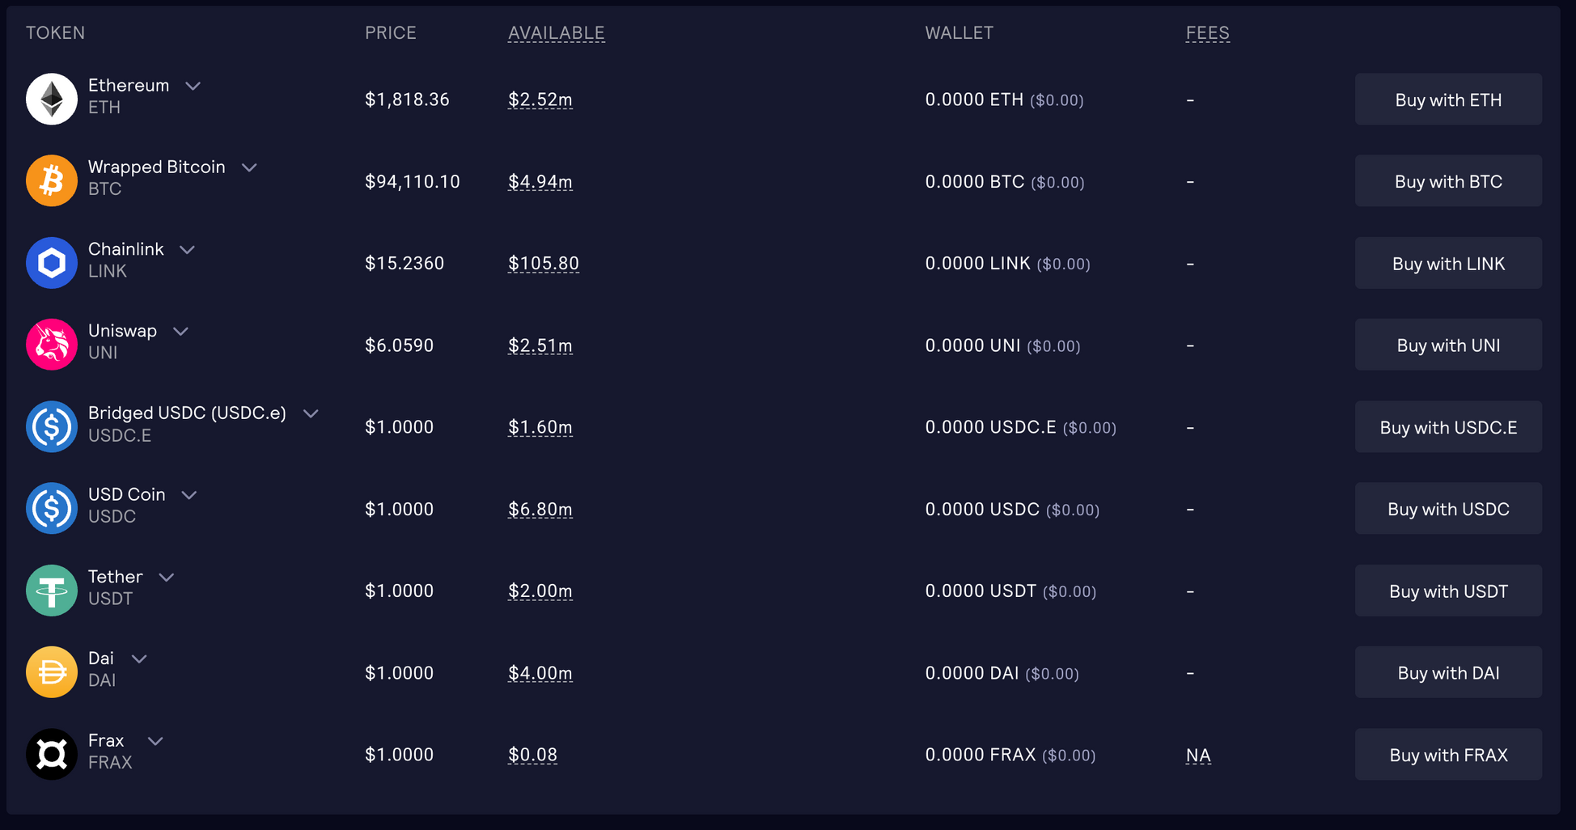
GMX USES ITS MULTI-ASSET POOL TO FULFIL ORDERS

Slide 16
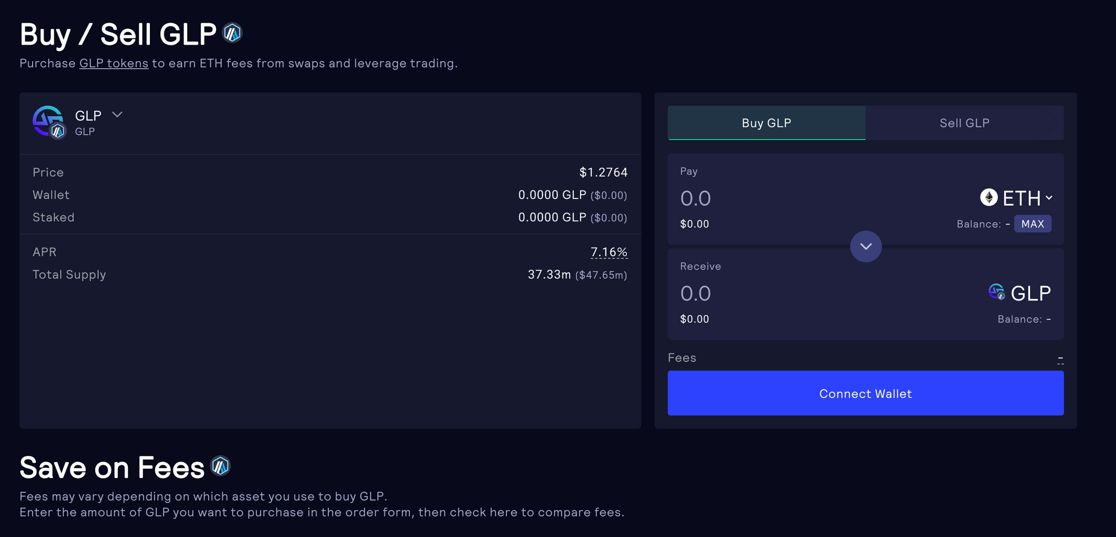

Slide 17
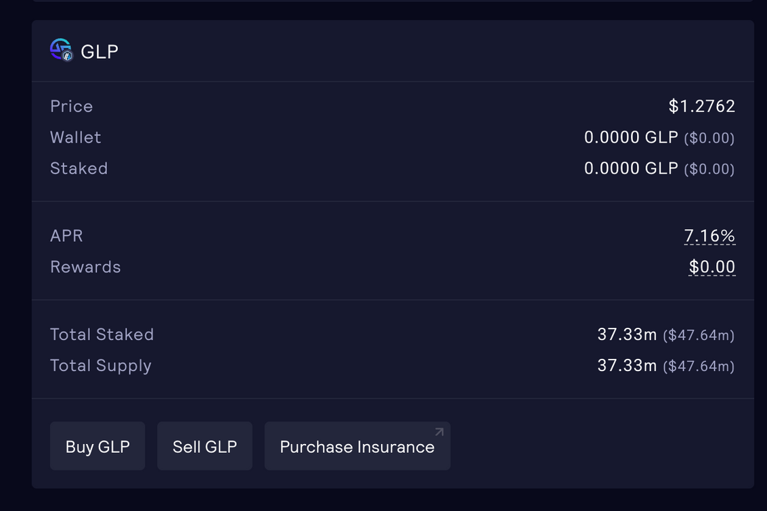
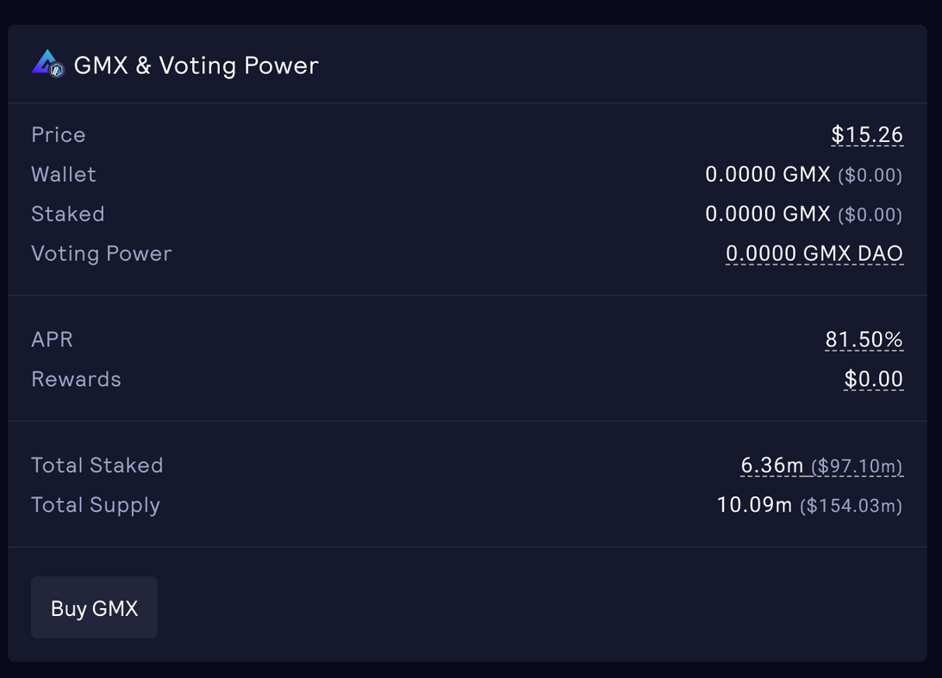
Users who mint GLP supply this liquidity and automatically receive 70% of the protocol’s trading fees, all while avoiding the impermanent‐loss risk typical of many pools. The other 30% will be distributed to staked GMX holders; depending on the network the user staked, they will receive AVAX or ETH.

Slide 18
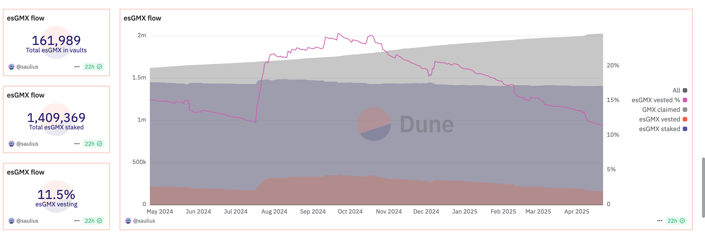
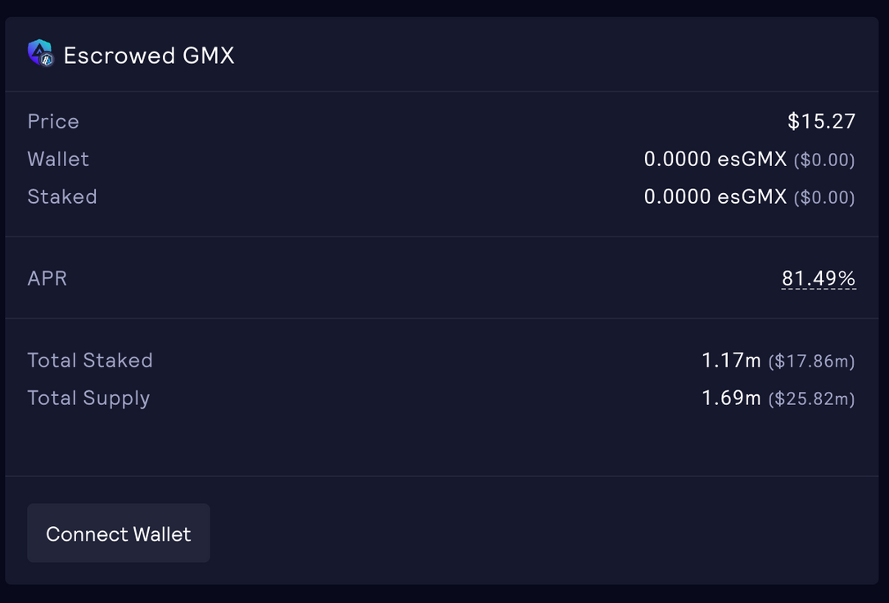
BY STAKING GMX, USERS WILL RECEIVE ESCROWED GMX (ESGMX)

Slide 19

STRENGTHS AND WEAKNESSES

Slide 20
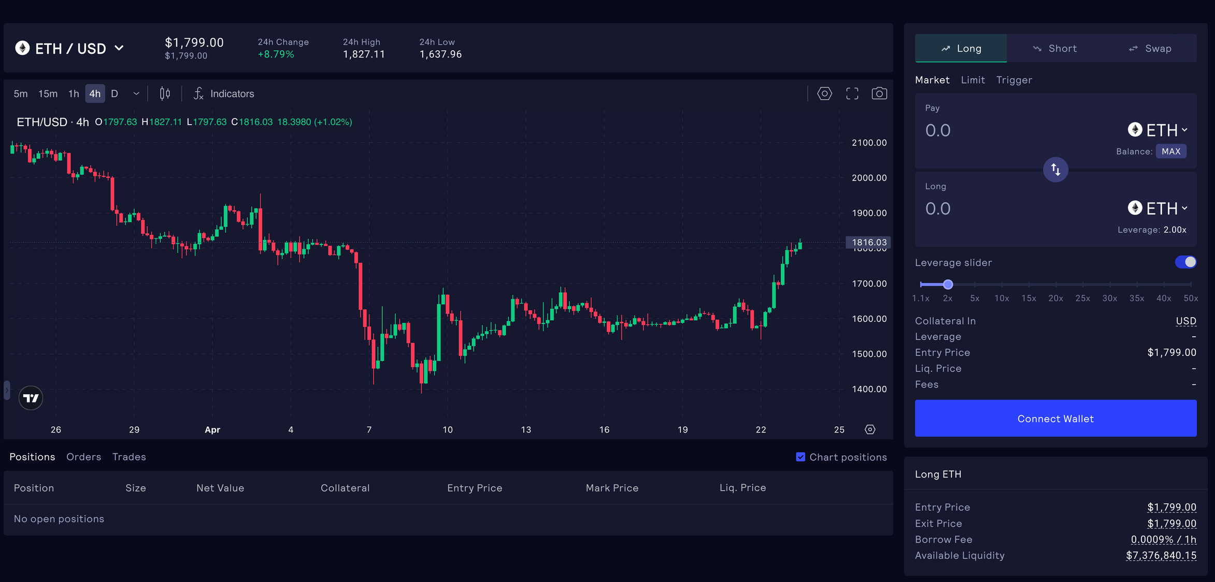

Slide 21
V1 WAS CREATED WITH ZERO PRICE IMPACT -> LARGE INVESTORS AS IT ALLOWED THEM TO KEEP THEIR CAPITAL ON THE EXCHANGE FOR A LONG TIME.
THIS VERSION ALSO FAILED TO BALANCE OPEN INTEREST AND UNUTILIZED CAPITAL, WHICH NOT ONLY REPRESENTED AN OPPORTUNITY COST FOR LIQUIDITY PROVIDERS BUT ALSO POTENTIALLY LIMITED THE OVERALL EFFICIENCY OF THE PLATFORM.
GMX INTRODUCED GLP, BUT IT WAS TOO COMPLEX FOR INVESTORS; THE SKYROCKETING TRADING VOLUME EXPOSED THE WEAKNESSES OF THIS VERSION AND SHOWED THE NEED TO SCALE TO MATCH THE DEMAND

Slide 22
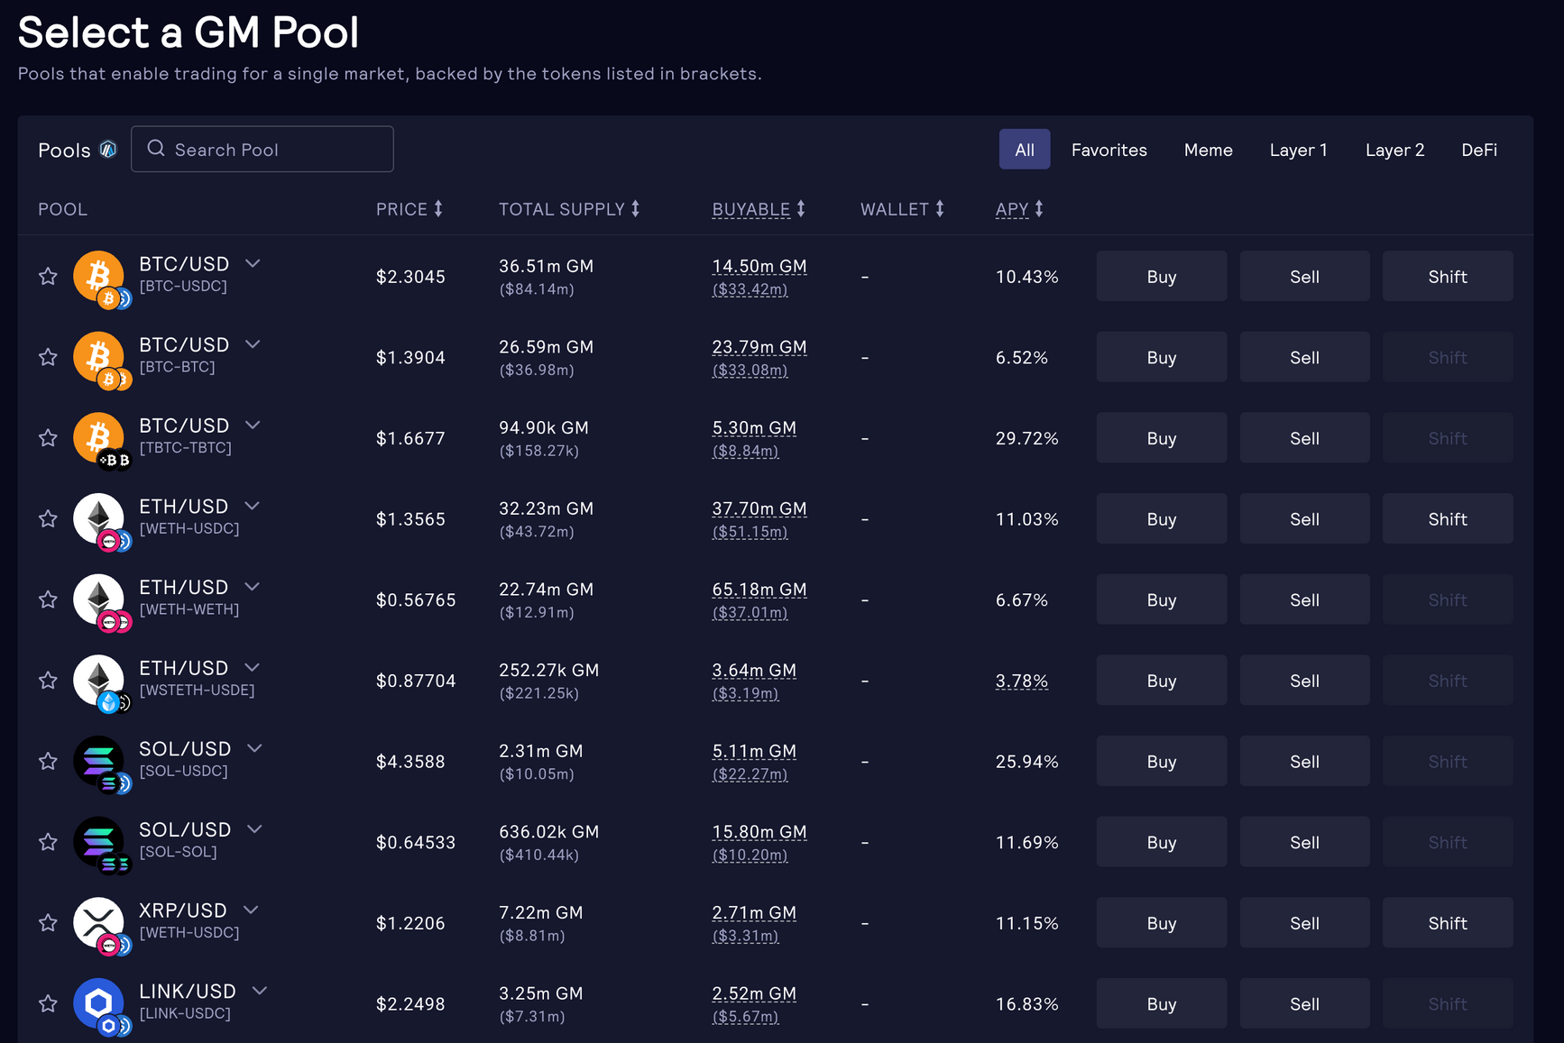
GM POOLS CAN HELP LIQUIDITY PROVIDERS OFFER ANY ASSET THE DAO ALLOWS. IN ADDITION, GMX V2 SUPPORTS A LOT OF TOKENS

Slide 23
Oracle-Priced AMM Model:
  Simpler than CLOBs
  Lets all users (not just market makers) earn fees
  More transparent and decentralized
CLOB Advantages:
  Full order visibility enables cost-saving and price discovery
  Less reliant on external liquidity
  Can offer faster execution and reduce frontrunning

Slide 24
Security Measures:
  Regular audits and bug bounties in place
Ongoing Risks:
  Vulnerable to cross-protocol attacks due to DeFi interconnectivity
  Reliance on Chainlink oracles exposes GMX to oracle manipulation risks
  Complex GLP pool model may contain smart contract vulnerabilities
  Exploits could rapidly drain liquidity and impact protocol solvency

Slide 25
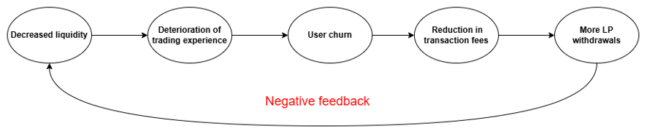
GLP holders earn fees but face counterparty and liquidity risks, especially during prolonged market downturns or stablecoin instability.

Slide 26
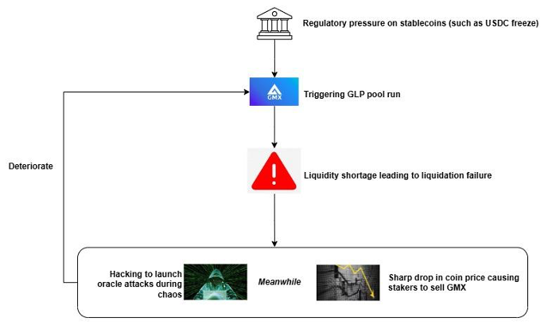
The power of regulatory agencies

Slide 27
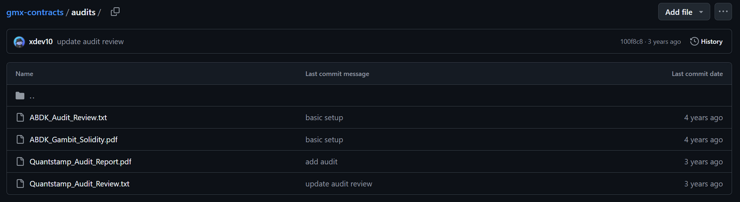
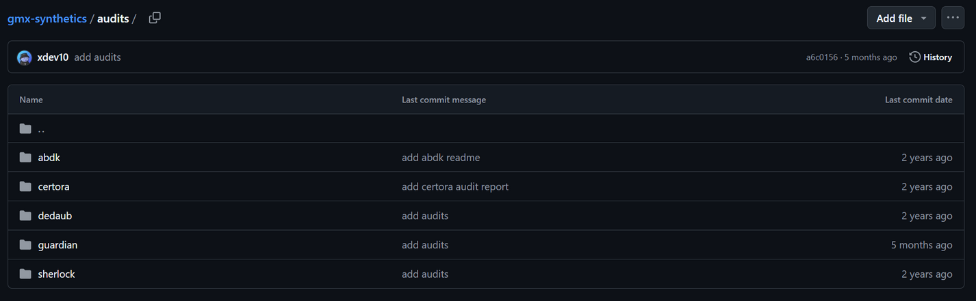
Audit
V1 Audit Reports on Github
V2 Audit Reports on Github
GMX is paying more and more attention to its protocol security!

Slide 28
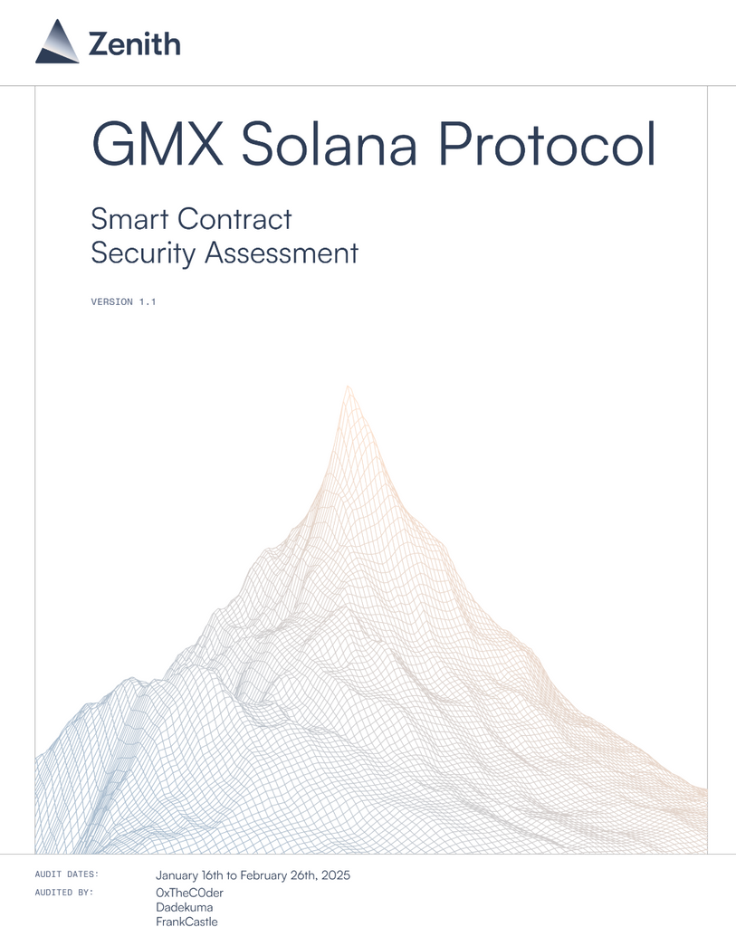
Audit
  GMX Audit Reports on Solana

Slide 29
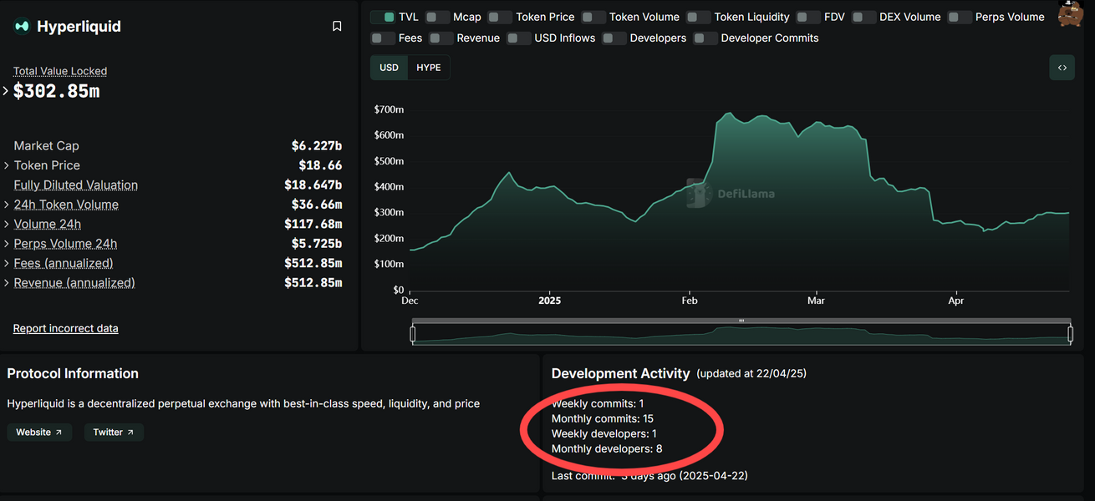
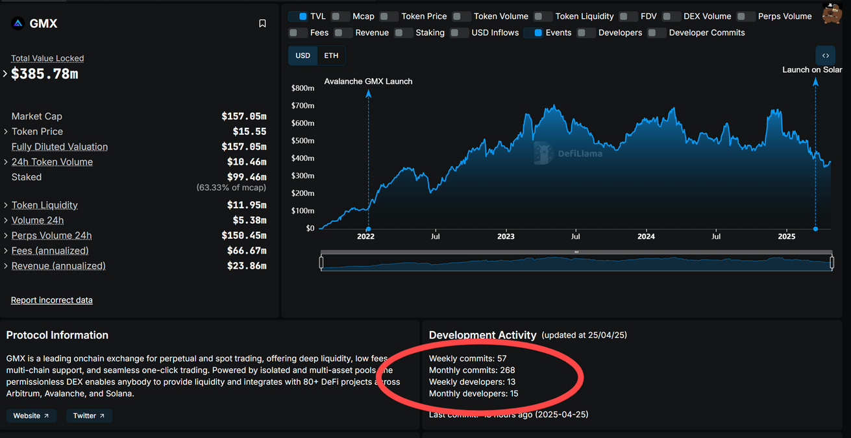
Activities on GitHub - Compared to Hyperliquid
Hyperliquid
GMX

Slide 30

HOW MAY GMX FAIL IN THE FUTURE?

Slide 31
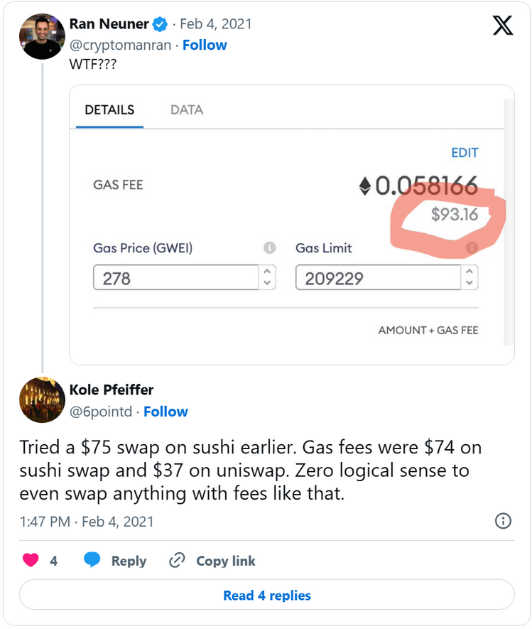
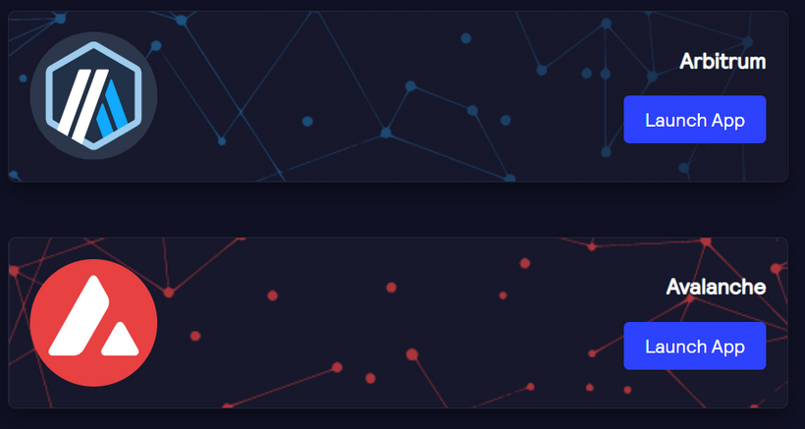
1.Due to public blockchains congestion
Is it really reliable during peak hours?
Example: In 2021, gas fees on Ethereum (Since the popularity of NFT)

Slide 32
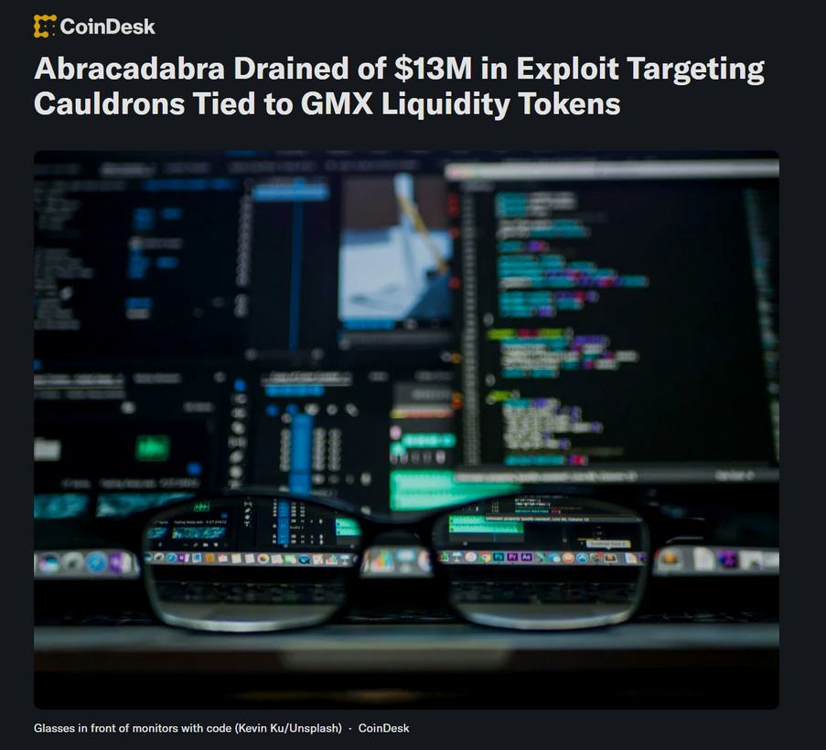
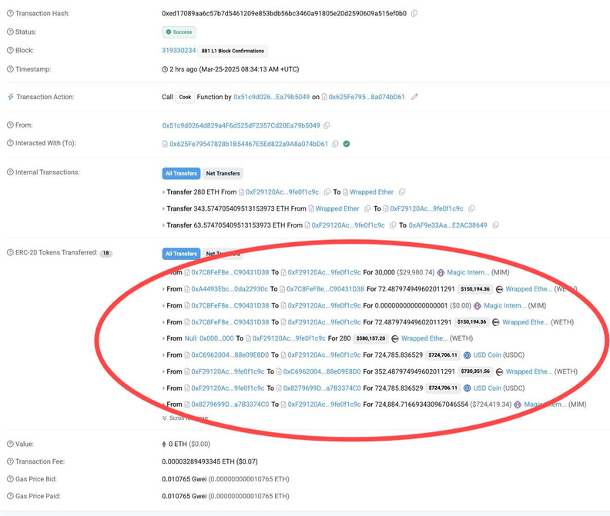
2.Smart contract risk
  If bugs exist in smart contracts, can be exploited, potentially leading to loss of funds.
On 26th March, 2025 Abracadabra’s Cauldron exploited led to a loss of 13 millions dollar and the issue was confined to the integration with GMX V2,
which uses GMX’s liquidity pools for their operations.

Slide 33
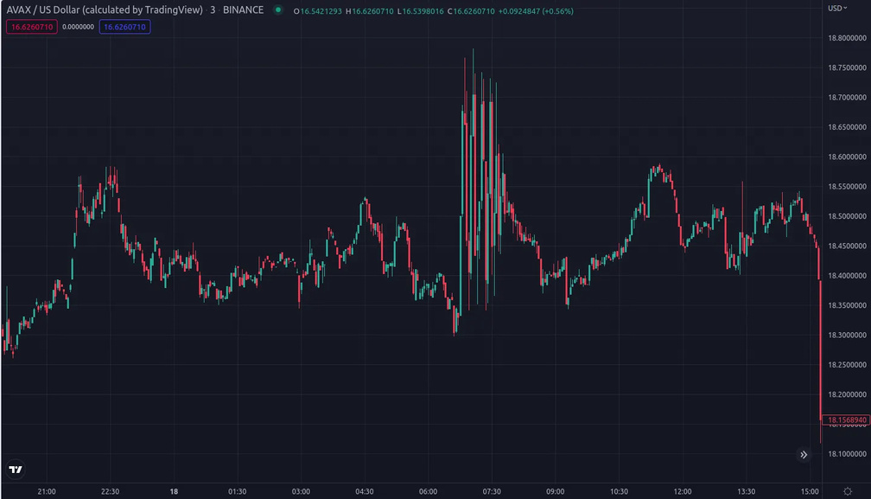
3.Market manipulation
  As someone bought the perp, moved the underlying price on Binance to sell and repeat
  Means that if tokens trading on GMX could be manipulated
  Moreover, it also proves the problem about oracle and the lack of slippage on GMX trades
On 20th September, 2022, GMX suffered an attack on their AVAX perps

Slide 34
Thank you for listening
z5627682-Xuan Bach Mai (Mike)
z5558347-Chengchen Yang (Young)
z5368805-Tsun Fen Wilfred Wu (Wilfred)

